Slide 1
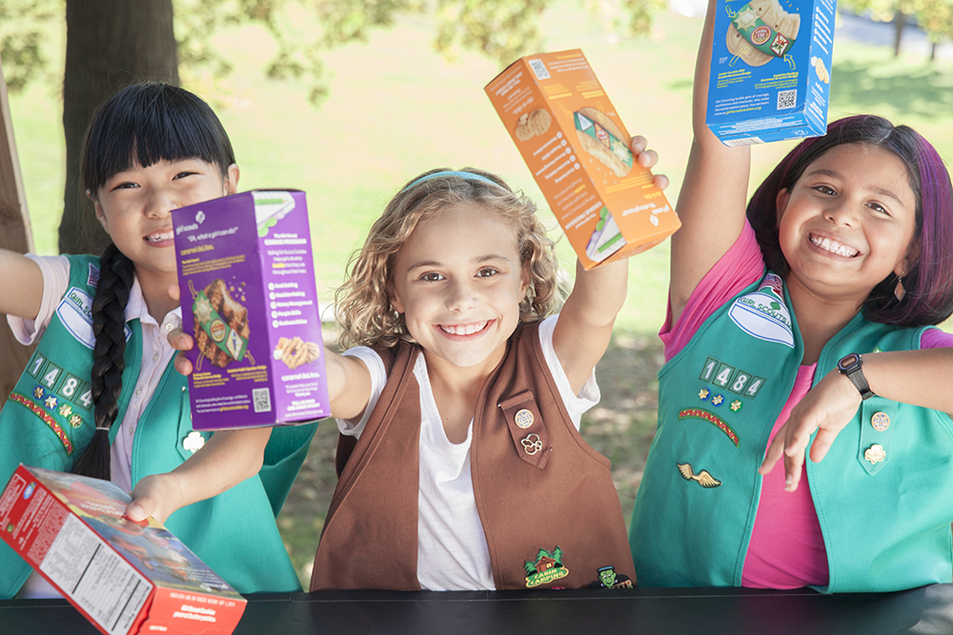
Powered by G.I.R.L Scouts and YOU!
Notes:
Thank you for your time today. My name is – and I am here representing Girl Scouts of South Carolina – Mountains to Midlands. (next slide)

Slide 2
If you could make a difference in the world, would you?
Notes:
I have a question for you – if you could make a difference in the world, would you? (wait for response). Great! I am here today to present an opportunity for you to make a difference.

Slide 3
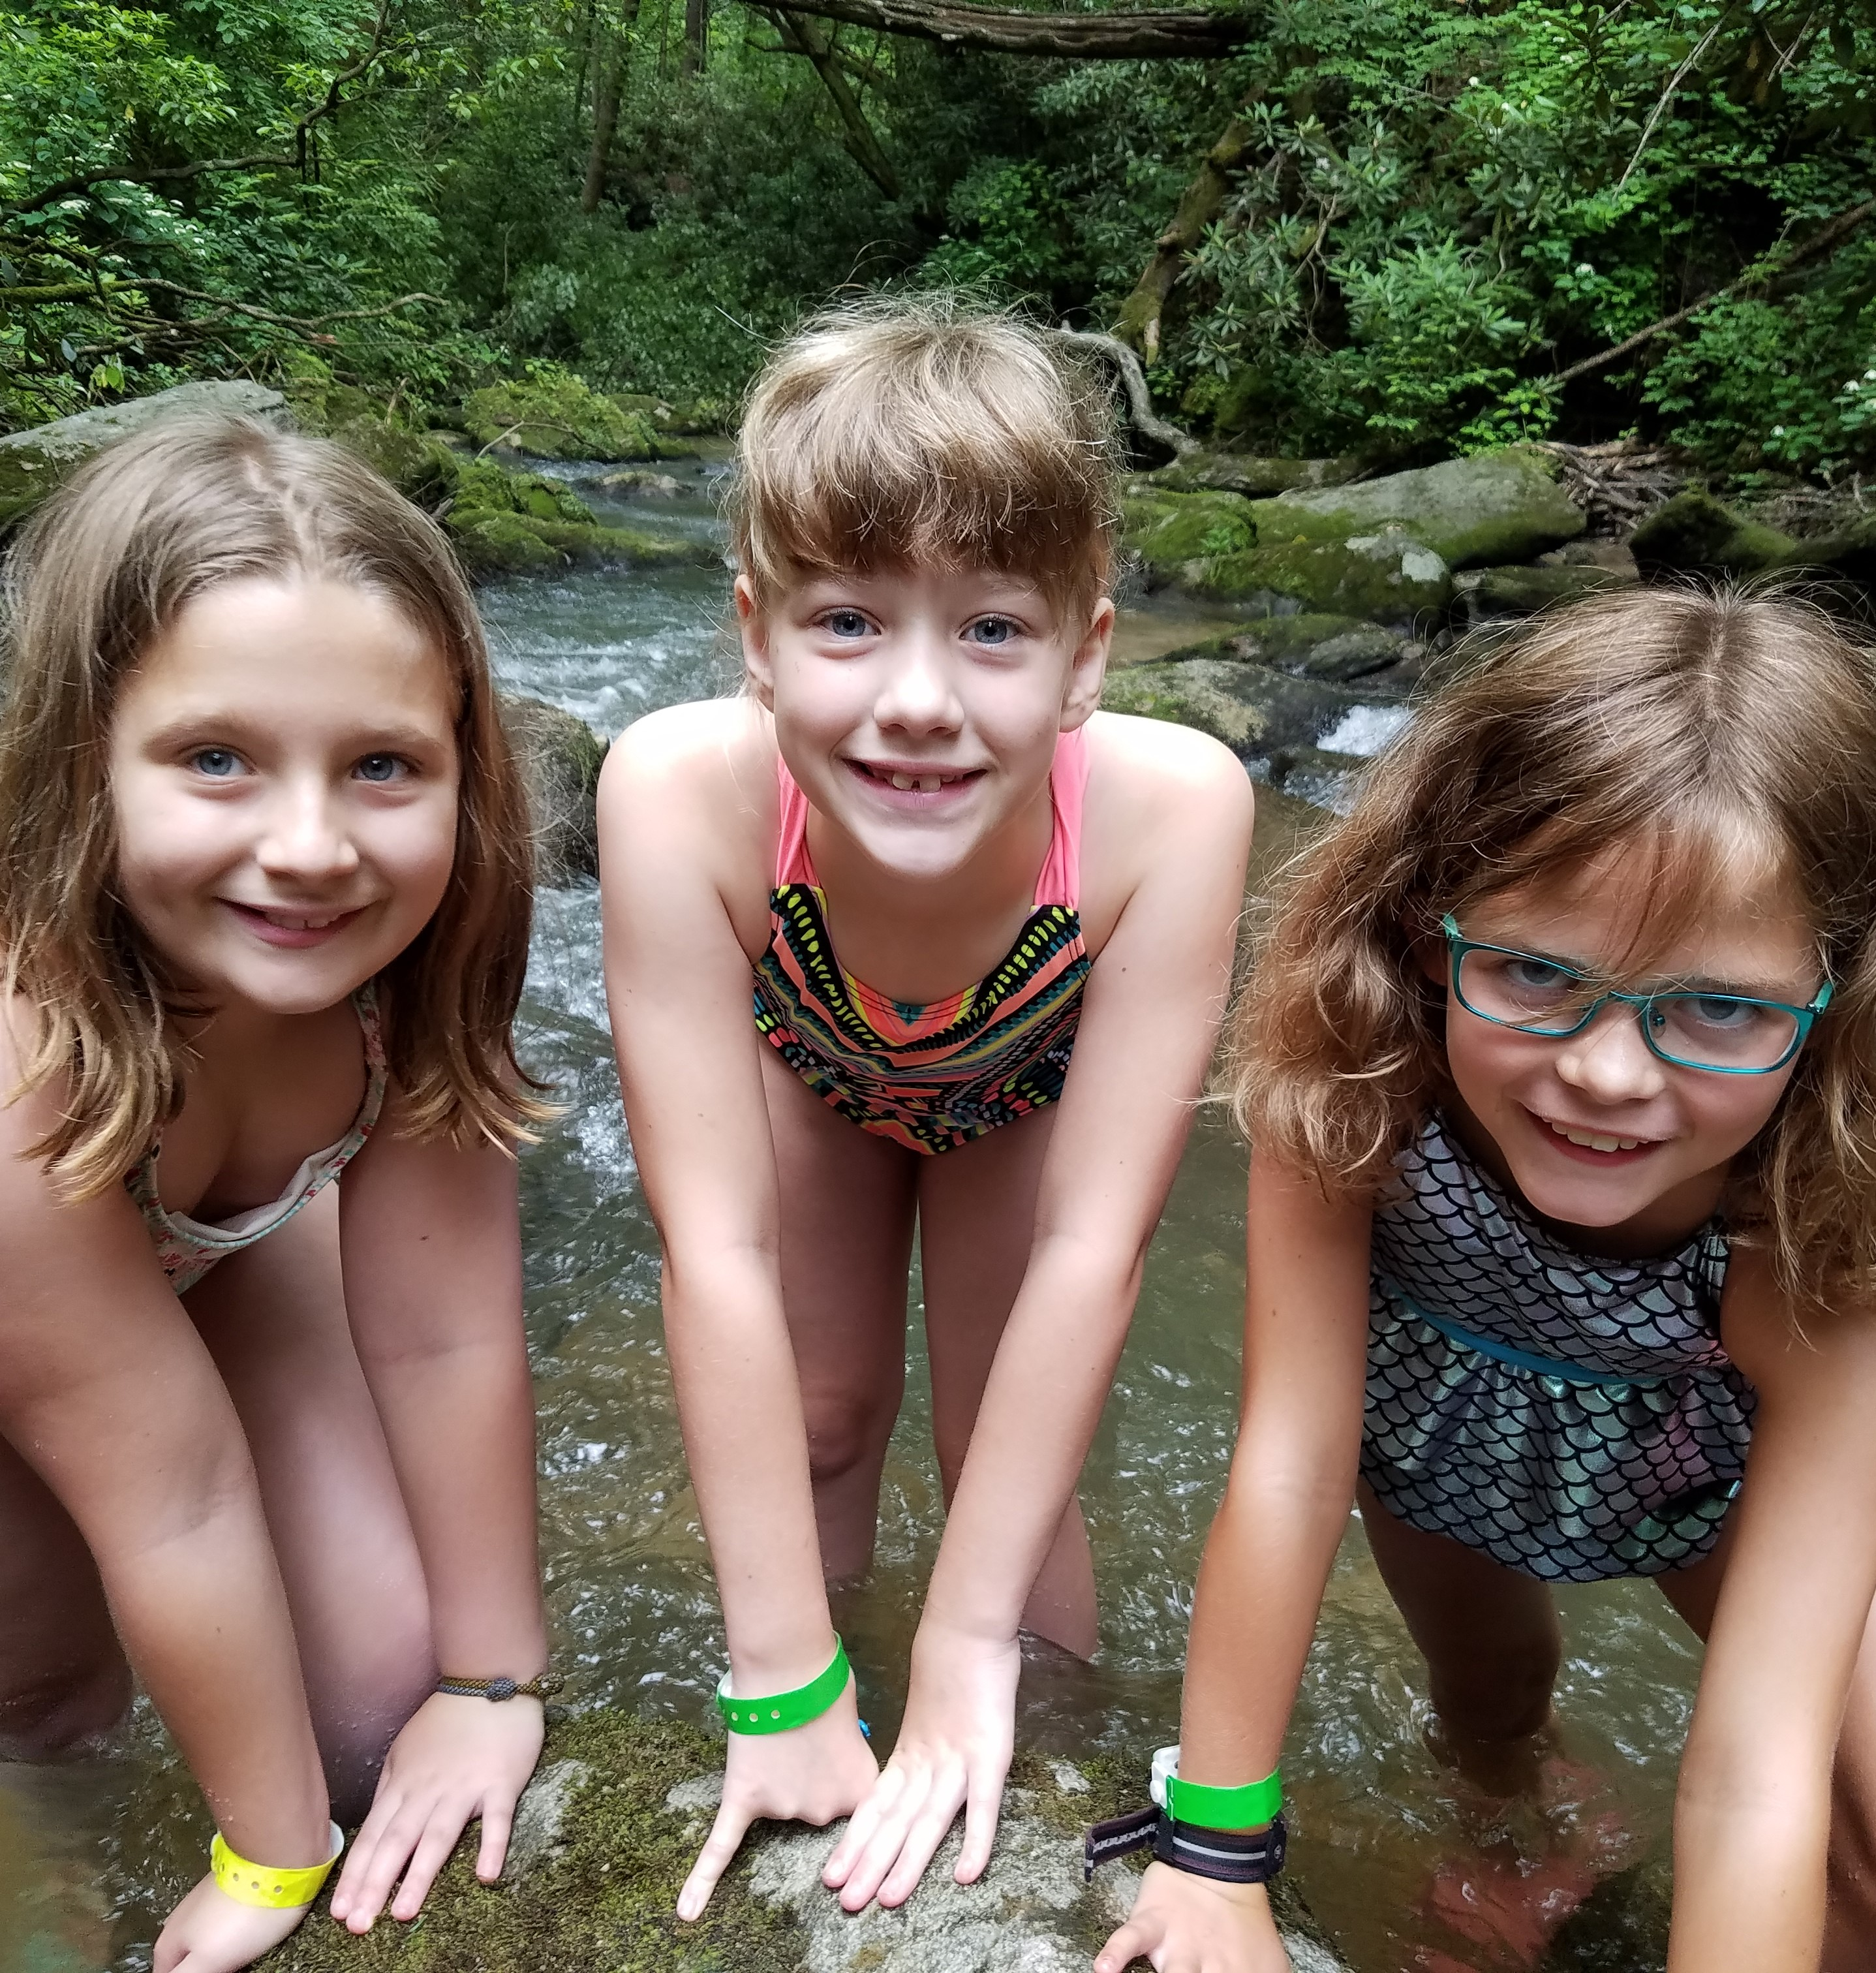
Girl Scout Leadership Experience
Proven Results
Research Backed Programming
Explore Potential
Learn to Lead
Notes:
from taking a night-time hike under the stars to accepting a mission on the International Space Station; from lobbying the city council with her troop to holding a seat in Congress; from running her own cookie business today to tackling cybersecurity tomorrow.
Our Girl Scout Leadership Experience is a one-of-a-kind leadership development program for girls, with proven results. It is based on time-tested methods and research-backed programming that help girls take the lead—in their own lives and in the world.
Research shows that girls learn best in an all-girl, girl-led, and girl-friendly environment. Girl Scouts is a place where she’ll practice different skills, explore her potential, take on leadership positions—and even feel allowed to fail, dust herself off, get up, and try again.

Slide 4
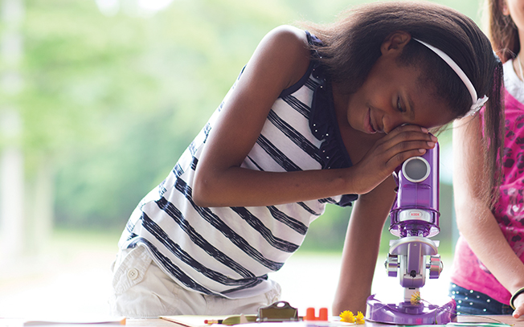
More than Cookies…
Founded on March 12, 1912 by Juliette Gordon Low
Builds girls of courage, confidence and character who make the world a better place.
1.7 million girls and 750,000 adults who believe in the power of every G.I.R.L
Girl Scouts of South Carolina – Mountains to Midlands Council is the largest organization serving girls in the state
Notes:
When you think of Girl Scouts – what’s the first thing that comes to mind? Cookies, right? While we are very proud of the opportunity that selling those delicious cookies provides for our girls, we are much more than cookies. Juliette Gordon Low founded Girl Scouts in 1912 because she envisioned an organization that prepare girls to make the world a better place by building their courage, confidence and character. More than 100 years later, the organization has grown to 1.7 million girls and 750,000 adults who believe in the power of every girl. I represent Girl Scouts of South Carolina – Mountains to Midlands Council which is the largest organization serving girls in the state.

Slide 5
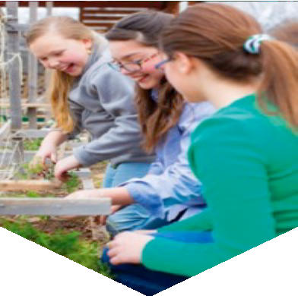
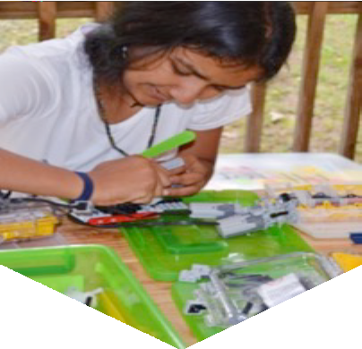
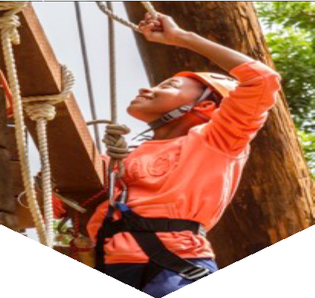
More than girls…we are G.I.R.L.S
Go-getter
Innovator
Risk-taker
Leader
Express vision, ambition, and persist through challenges
Problem solve with creativity, curiosity, and resourcefulness
Make decisions,
face fears, take on new experiences
Empathize, identify strengths, and empower others
G
I
R
L
5
Notes:
We are more than girls…we are G.I.R.L.S – go-getters, innovators, risk-takers and leaders.
G.I.R.L. describes how we take the lead everyday. G.I.R.L. experiences and skills create our idea of leadership—leadership, the Girl Scout way—through everything we do. It’s at the heart of who we are as a Movement, what our program is all about.

Slide 6
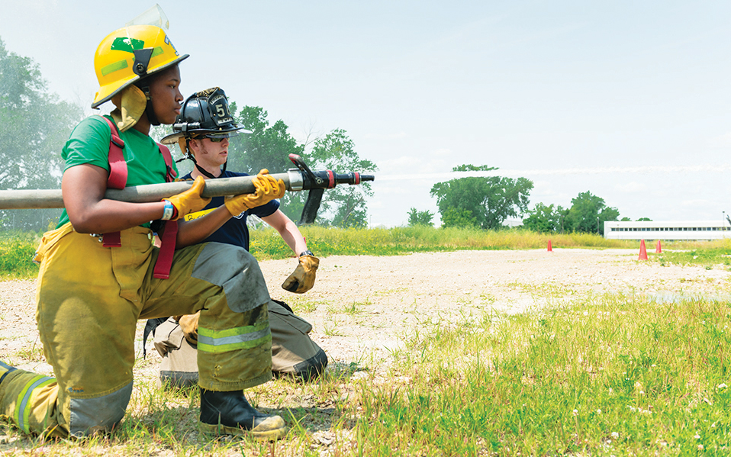
The Girl Scout Difference
Unleashing the G.I.R.L
Girl Scout Leadership Experience
Inclusive, all-female environment
Helping girls thrive in five key ways
Notes:
Girl Scouts unleashes the go-getter, innovator, risk-taker and leader and every girl, preparing her for a lifetime of leadership; from running her own cookie business today to tackling cybersecurity tomorrow. Our Girl Scout Leadership Experience is a one of a kind leadership development program for girls whose proven results help girls take the lead in their own lives and the world. Research shows that girls learn best in an all-girl, girl-led and girl friendly environment. Girl Scouts is proven to help girls thrive in five key ways (next slide).

Slide 7

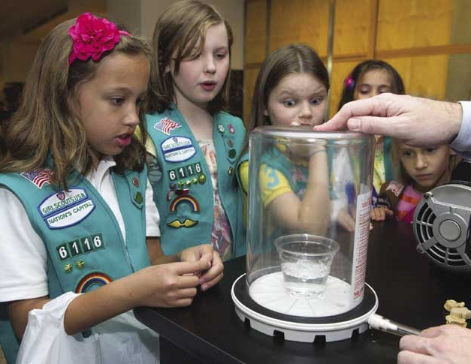
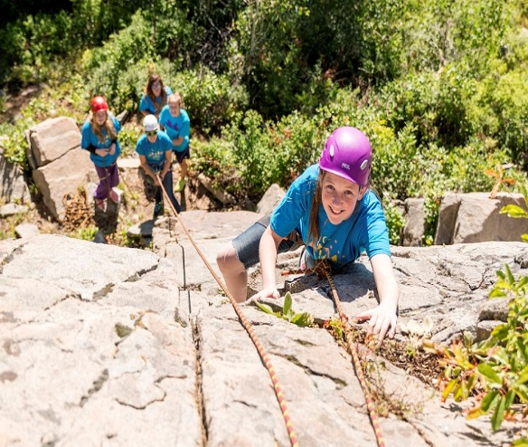


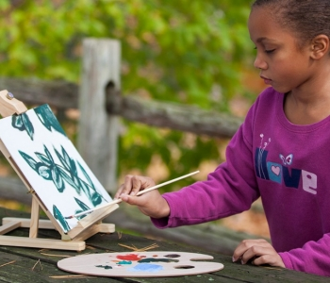
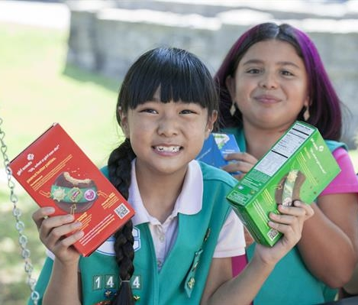


Girl Scout Outcomes
Take Action to Change the World
SENSE OF SELF
POSITIVE VALUES
CHALLENGE SEEKING
STEM
Outdoor
HEALTHY RELATIONSHIPS
COMMUNITY PROBLEM SOLVING
Life Skills
Entrepreneurship
Girl Scout Leadership Experience
Notes:
We know that Girl Scouts are developing the exact leadership skills that are in decline.
Through our national curriculum, girls learn about themselves and their values and stretch to seek and meet challenges beyond what they might in other settings.
Through STEM (did you know there are space badges—and a cyber security badge coming soon).. Through STEM, Outdoors education, healthy living programs, and civic engagement work--
These are the outcomes of our program.
Who wouldn’t want this for their daughter, grand-daughter, niece..any female relative.

Slide 8
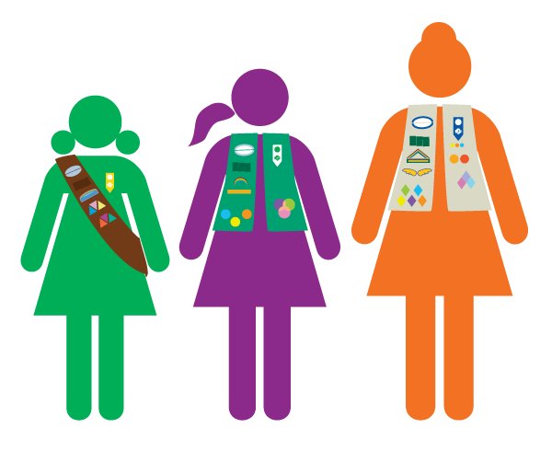
Fueling the Female Leadership Pipeline
52% of Female Business Leaders
72% of Female U.S. Senators
100% of Female U.S. Secretaries of State
Notes:
22 Girl Scout Alums shattered the glass ceiling in politics in the 2018 mid-term elections including Alexandria Ocasio-Cortez, who was the youngest woman elected to congress.
Other notable girl scouts alums include journalist Katie Couric, tennis legend Venus Williams and CEO of YouTube Susan Wojcicki.

Slide 9
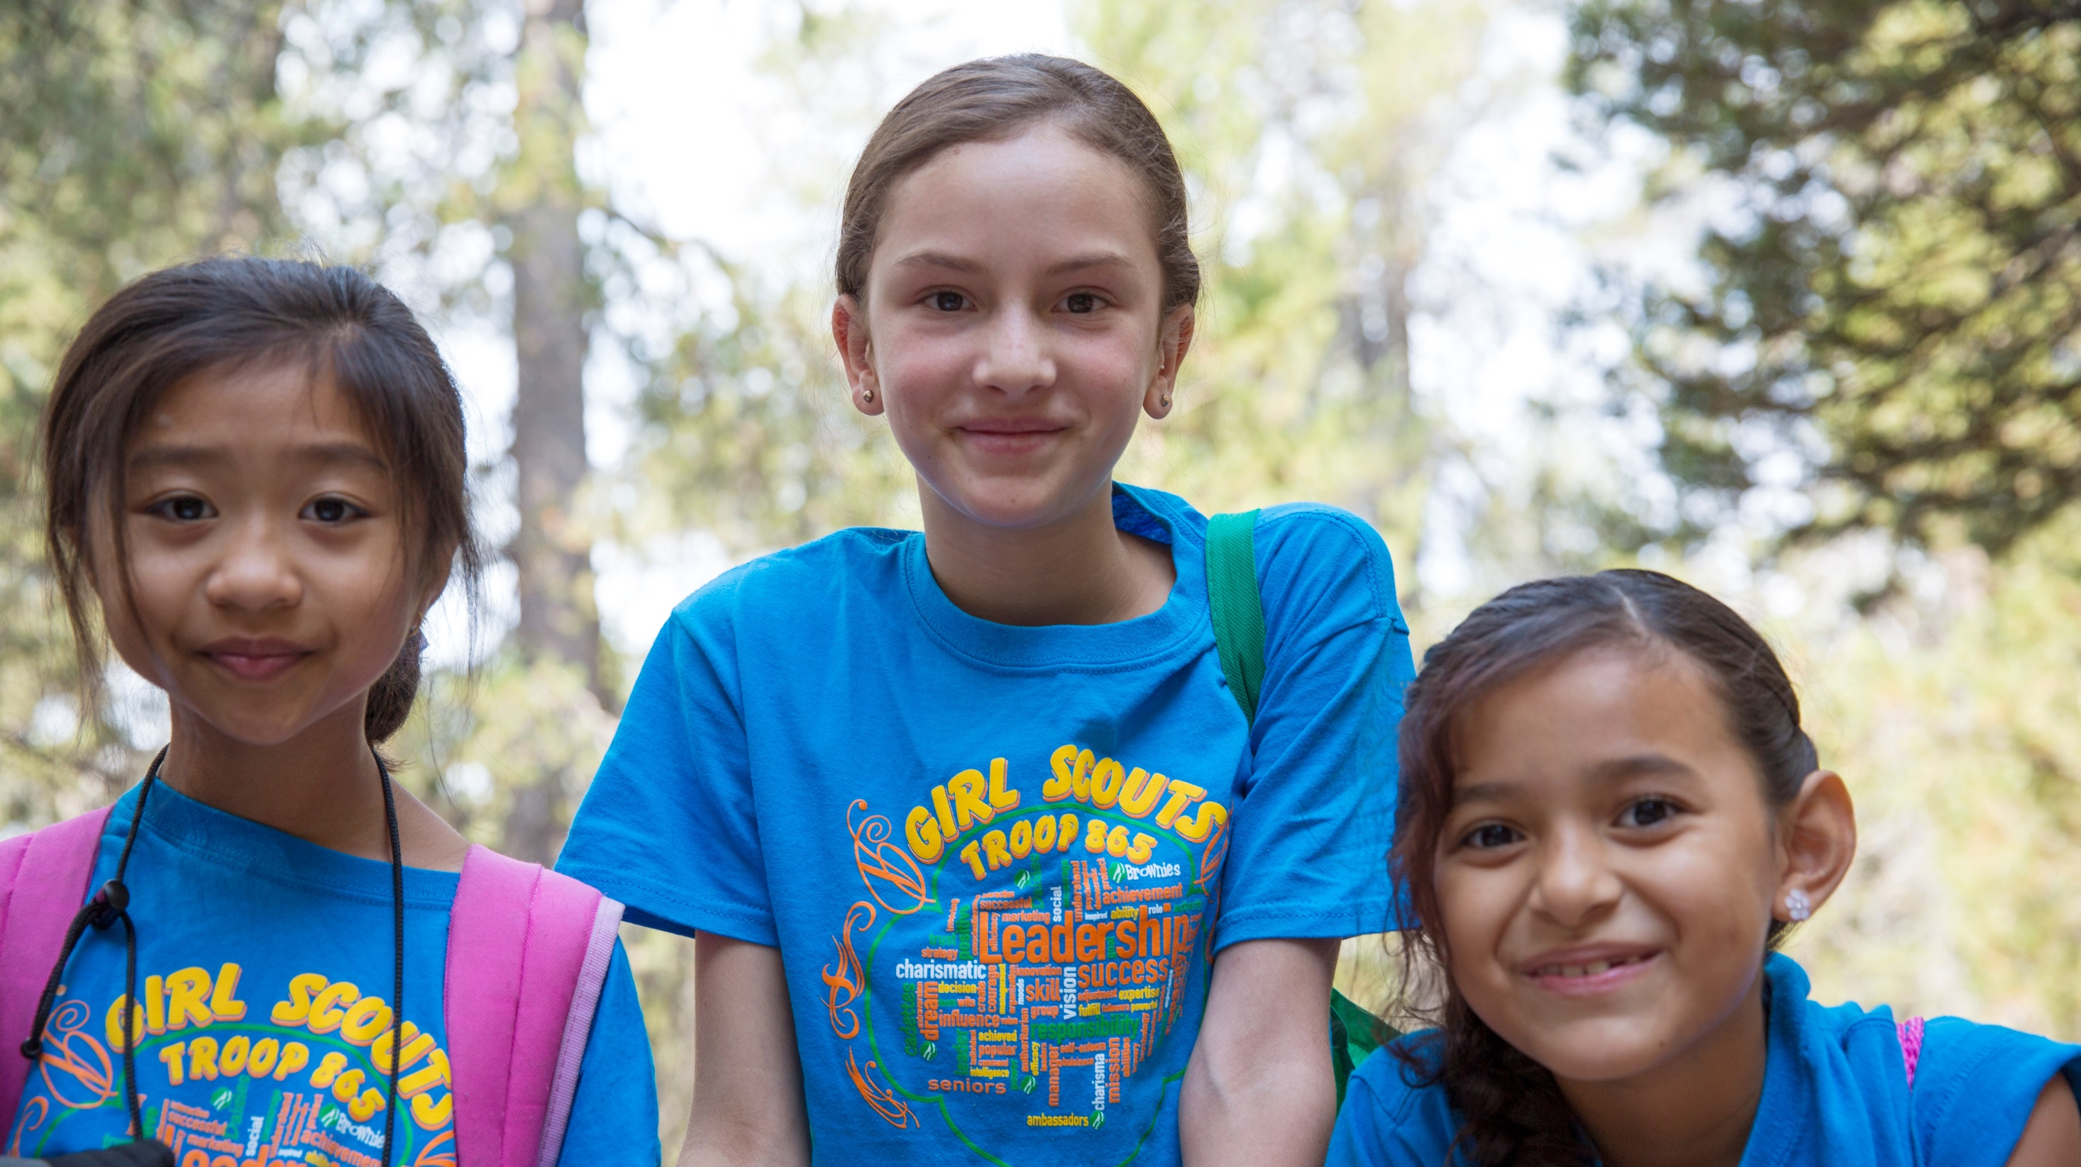
If we want more leaders, we need more Girl Scouts.
Notes:
So, the answer is clear. If we want more leaders—leaders who are prepared to practice grit, problem solving, risk-taking, and empathy—we need more Girl Scouts.

Slide 10

Powered by YOU!
Many ways to volunteer…
WEEKLY/Bi-WEEKLY – Support girls as a troop leader and watch her grow
MONTHLY – Support fellow adults as a Service Unit volunteer
SEASONAL – Support troops and troop leaders as a Product Program volunteer
2-3 TIMES PER YEAR – Ensure that girl programming has enough adult support as an episodic program volunteer
AS NEEDED – Ensure the proper onboarding and professional development of volunteers as an Adult Learning Facilitator
Notes:
Girl Scouts doesn’t work without the power of our volunteers. Volunteers play a critical role in the success of Girl Scouts. There are many ways that you can volunteer. No matter how much time you are able to commit, YOU can make a difference.

Slide 11
Bring a Buddy
Girl Scouting works with teamwork
Ask potential volunteers who else they know that they want to invite to be a part of the program with you
60% of the time people will join with a friend or acquaintance
You don’t know until you ask
Notes:
As you speak with adults (and with girls) about volunteering and joining always ask who else they know that might be interested in Girl Scouts. Collect names and phone numbers. A majority of the time this works. And you’ll never know if you don’t ask.

Slide 12
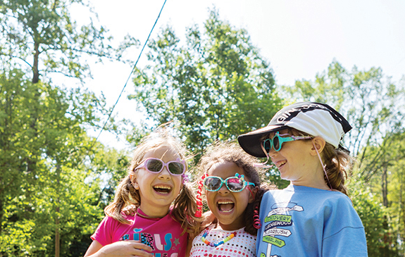

Girl Scout volunteers LOVE changing lives!
Notes:
You too have the opportunity to guide, mentor and cheer girls on as they take the lead, advocating for themselves and their communities to create the future they want to see.
https://youtu.be/4qhcZCDsxiw

Slide 13
Benefits of Volunteering
1. Volunteering time makes you feel like you have more time.
2. Volunteering your skills helps you develop new skill.
3. Volunteering your body helps you have a healthier body.
4. Volunteering your experience helps build your experience.
5. Volunteering your love makes you feel more love.
Notes:
1. Volunteering time makes you feel like you have more time.
“The results show that giving your time to others can make you feel more ‘time affluent’ and less time-constrained than wasting your time, spending it on yourself, or even getting a windfall of free time.”
2. Volunteering your skills helps you develop new skills.
“Skills-based volunteering is an excellent opportunity to develop talents to help you get ahead in your career.”
3. Volunteering your body helps you have a healthier body.
A Corporation for National & Community Service report noted: “Research demonstrates that volunteering leads to better health… those who volunteer have lower mortality rates, greater functional ability, and lower rates of depression later in life than those who do not volunteer.”
4. Volunteering your experience helps build your experience.
According to the Wall Street Journal: “A survey of 200 human-resource executives, skilled volunteer work — makes job applicants look more appealing to hiring manager.”
5. Volunteering your love makes you feel more love.
Admittedly, love is a hard thing to measure. But when researchers at the London School of Economics examined the relationship between volunteering and measures of happiness, they found the more people volunteered, the happier they were. Volunteering builds empathy, strengthens social bonds and makes you smile — all factors that increase the feeling of love.

Slide 14
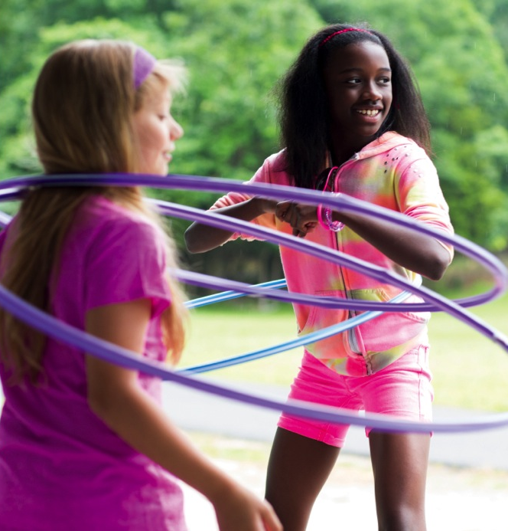

What’s Next?
Register TODAY!!
Volunteer Buddy
Feel good about taking the next step toward making a difference!
Notes:
Register today on our website. Think about who you’d like to take on this life changing journey. Who would you like to be your volunteer buddy? Finally, feel good about taking the next step toward making a difference in the lives of many girls and the world!
**Get volunteer buddy information and ask for permission to make contact**

Slide 15
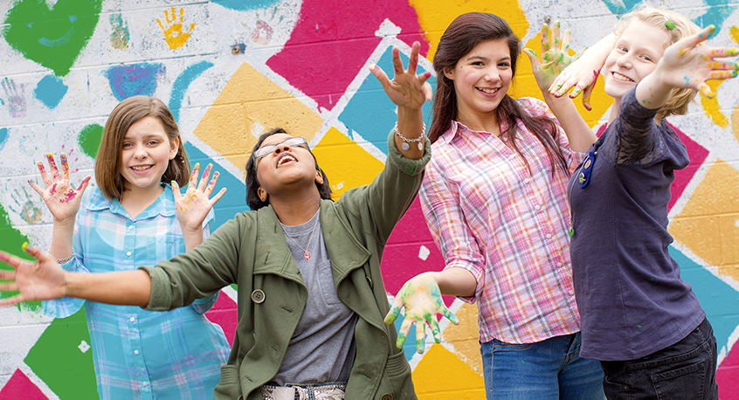
Ready, Set, Change Lives!!

Slide 16
Questions?
Name
Contact Information
Notes:
NOTES FOR USAGE:
This slide style is END SLIDE
Include contact information if necessary

